Slide 1
Review Session 8
API-201, 11.12.21
Sophie Hill

Slide 2
Agenda
3 methods of hypothesis testing
Guidance on using weights for the final exercise

Slide 3
Example
Suppose we want to test if the average height of students in school A and school B is the same.
We take a random sample from each school and find that the students in school B are 6cm taller on average.
Is this difference statistically significant at alpha = 0.05?

Slide 4
Example
Suppose we want to test if the average height of students in school A and school B is the same.
We take a random sample from each school and find that the students in school B are 6cm taller on average.
Is this difference statistically significant at alpha = 0.05?
 | School A | School B
Sample std dev | 12.2 | 17.9
Sample size | 28 | 30
What is the standard error of the difference in means?

Slide 5
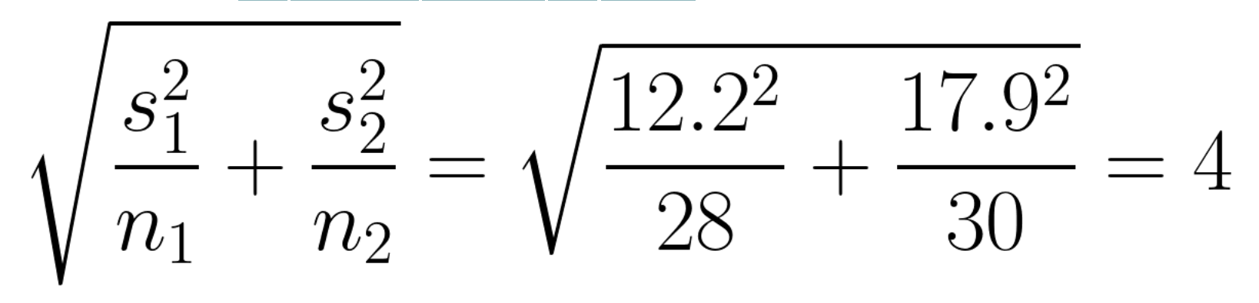
Example
Suppose we want to test if the average height of students in school A and school B is the same.
We take a random sample from each school and find that the students in school B are 6cm taller on average.
Is this difference statistically significant at alpha = 0.05?
 | School A | School B
Sample std dev | 12.2 | 17.9
Sample size | 28 | 30
What is the standard error of the difference in means?

Slide 6
Example
Suppose we want to test if the average height of students in school A and school B is the same.
We take a random sample from each school and find that the students in school B are 6cm taller on average.
Is this difference statistically significant at alpha = 0.05?
 | School A | School B
Sample std dev | 12.2 | 17.9
Sample size | 28 | 30
What is the standard error of the difference in means?

Slide 7
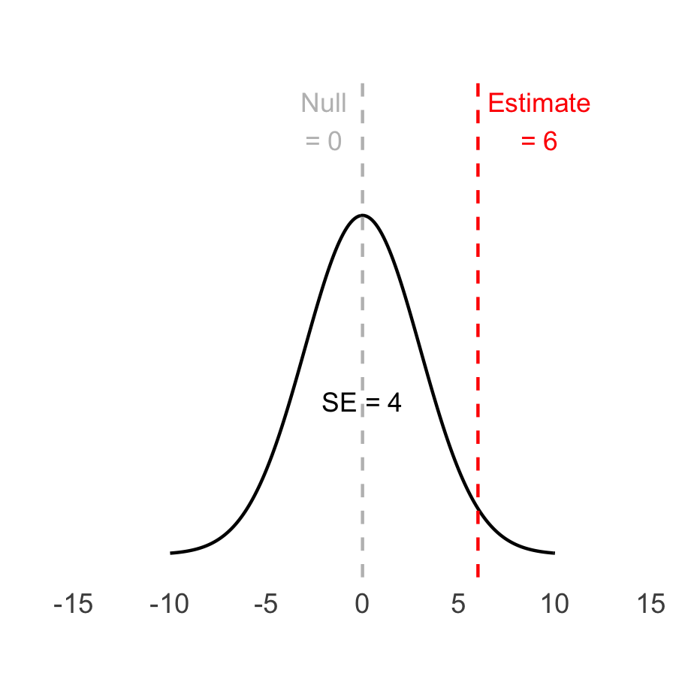
Example
Null hypothesis
H₀: 𝝻_{B} - 𝝻_{A} = 0
Estimate
x_{B} - x_{A} = 6cm
SE = 4cm

Slide 8
Method 1: p-value
T-statistic
= (est - null)/SE
= (6 - 0)/4 = 1.5
p-value
= TDIST( ABS(1.5), 28-1, 2)
= 0.15
p = 0.15 > 0.05 = 𝛂
→ Fail to reject

Slide 9
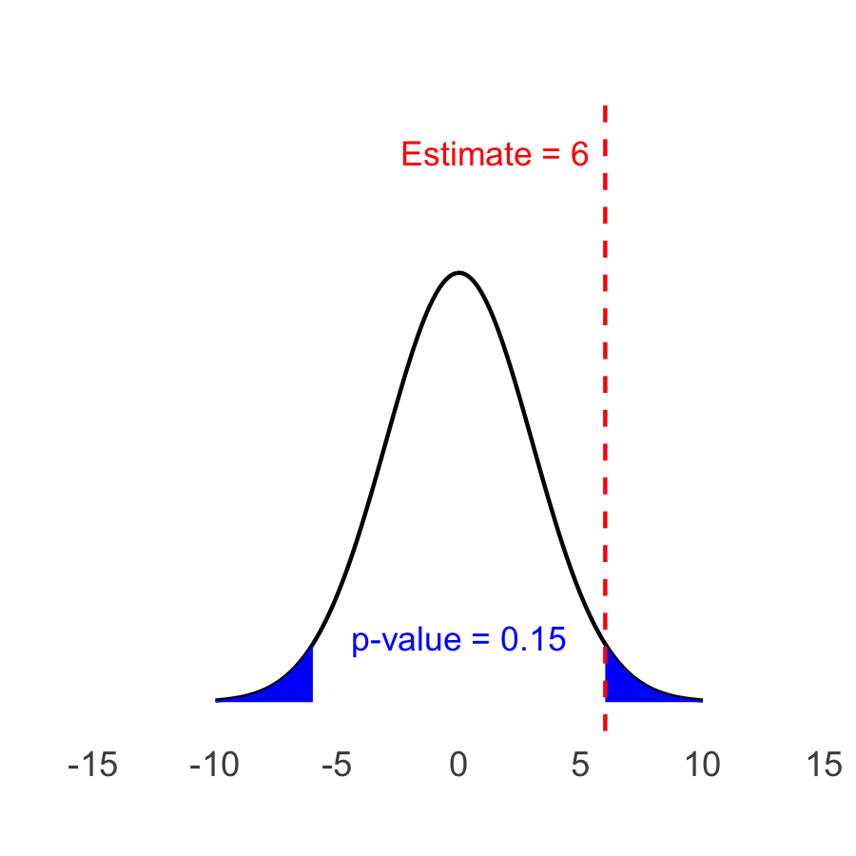
Method 1: p-value
T-statistic
= (est - null)/SE
= (6 - 0)/4 = 1.5
p-value
= =TDIST( ABS(1.5), 28-1, 2)
= 0.15
p = 0.15 > 0.05 = 𝛂
→ Fail to reject

Slide 10
Method 2: rejection region
𝜶 = 0.05, so usually our multiplier would be 1.96
Since we are using the t-distribution, it’s going to be a bit bigger.
You calculate this in Excel with =T.INV.2T(0.05, 27) = 2.05

Slide 11
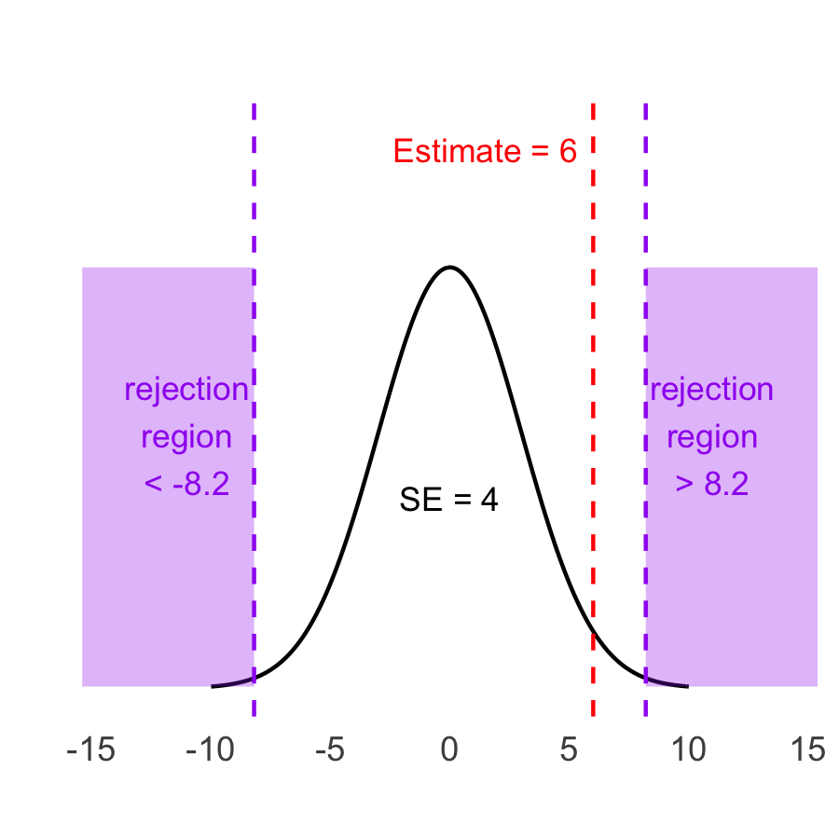
Method 2: rejection region
The rejection region is consists of values more extreme than:
Null value ± 2.05*SE
= 0 ± 2.05*4
= ± 8.2
Our estimate is 6cm, which does not fall in the rejection region.
→ Fail to reject

Slide 12
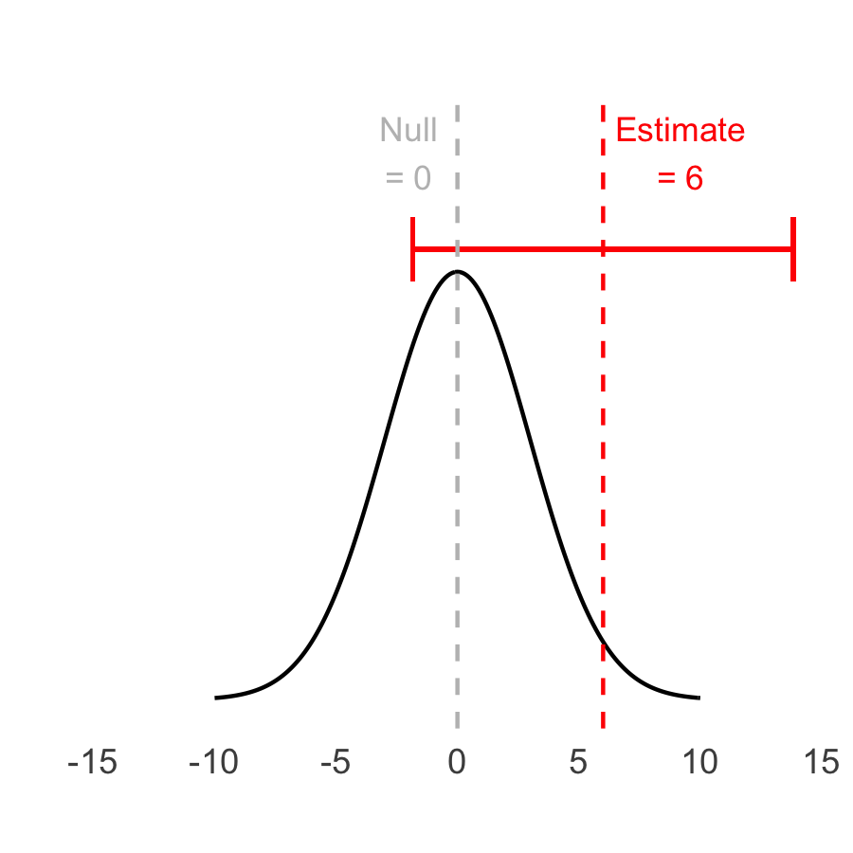
Method 3: confidence interval
We use the same multiplier as before: 2.05
But this time we are putting the estimate in the middle, not the null value!
The confidence interval is defined by:
Estimate ± 2.05*SE
= 6 ± 2.05*4
= [-2.2, 14.2]
The confidence interval includes our null value of 0cm.
Fail to reject

Slide 13
Three methods
p-value
Is the p-value of my estimate < alpha ?
Rejection region
Does my estimate fall in the rejection region?
Confidence interval
Does my confidence interval exclude the null?

Slide 14
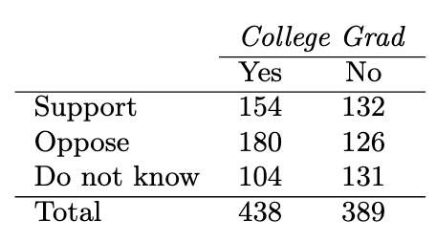
Practice problem
Here are the results of poll evaluating support for drilling for oil and natural gas off the coast of California.
What proportion of college grads and non-college grads support drilling for oil and natural gas?
OIS, Exercise 6.25

Slide 15
Practice problem
Here are the results of poll evaluating support for drilling for oil and natural gas off the coast of California.
What proportion of college grads and non-college grads support drilling for oil and natural gas?
q_{c}-hat = 154/438 = 0.352
q_{nc}-hat = 132/389 = 0.339
OIS, Exercise 6.25

Slide 16
Practice problem
Here are the results of poll evaluating support for drilling for oil and natural gas off the coast of California.
(b) Is the difference between these proportions statistically significant at the 5% level?
OIS, Exercise 6.25

Slide 17
Practice problem
Here are the results of poll evaluating support for drilling for oil and natural gas off the coast of California.
(b) Is the difference between these proportions statistically significant at the 5% level?
q_{c}-hat = 0.352 q_{nc}-hat = 0.339
H₀: q_{c} - q_{nc} = 0
Estimate = q_{c}-hat - q_{nc}-hat =
0.352-0.339 = 0.013
OIS, Exercise 6.25

Slide 18
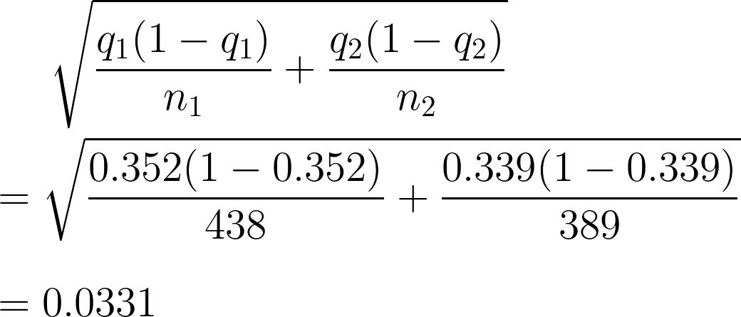
Practice problem
Here are the results of poll evaluating support for drilling for oil and natural gas off the coast of California.
(b) Is the difference between these proportions statistically significant at the 5% level?
OIS, Exercise 6.25

Slide 19
Practice problem
Here are the results of poll evaluating support for drilling for oil and natural gas off the coast of California.
(b) Is the difference between these proportions statistically significant at the 5% level?
Z-score = (est-null)/SE
= (0.013 - 0)/0.0331
= 0.393
OIS, Exercise 6.25

Slide 20
Method 1: p-value
Alpha = 0.05 Estimate = 0.013 SE = 0.0331 Z = 0.393
P-value = ?

Slide 21
Method 1: p-value
Alpha = 0.05 Estimate = 0.013 SE = 0.0331 Z = 0.393
P-value = 2*(1-NORM.S.DIST( ABS(0.393), TRUE) )
= 0.69
Conclusion?

Slide 22
Method 1: p-value
Alpha = 0.05 Estimate = 0.013 SE = 0.0331 Z = 0.393
P-value = 2*(1-NORM.S.DIST( ABS(0.393), TRUE) )
= 0.69
Conclusion? Fail to reject!

Slide 23
Method 2: rejection region
Alpha = 0.05 Estimate = 0.013 SE = 0.0331 Z = 0.393
Rejection region is the values more extreme than:
Null value +/- 1.96*SE = 0 +/- 1.96*0.0331 = +/- 0.0649
Our estimate = 0.013, which is not bigger than 0.0649 or smaller than -0.0649
Fail to reject!

Slide 24
Method 3: confidence interval
Alpha = 0.05 Estimate = 0.013 SE = 0.0331 Z = 0.393
The confidence interval is given by:
Estimate +/- 1.96*SE = 0.013 +/- 1.96*0.0331 = 0.013 +/- 0.0649
= [-0.0519, 0.0779]
Our confidence interval contains the null value of 0.
Fail to reject!

